Slide 1
self-balancing robot Bluetooth control
Duc Nguyen
Duong Truong

Slide 2
Concept of project
The main purpose of this idea was to design a two wheels robot which was able to stabilize even lifting items on it and remotely control in a medium range.
The target was to create a self- balancing robot with remote control via Bluetooth signal which would be utilized as a conductive household assistant.
With a self- balancing ability and mobilizing on different types of surface, the robot could be the most fitting choice in family uses such as carrying goods then delivering to designated points.

Slide 3
Electronic components
Arduino Uno R3
Inertial Measurement Unit MPU-6050
DC Gear Motors
L298 Dual H-Bridge DC Motor Drive
HC-05 Bluetooth Module
Batteries
Jumper Wires
9V Battery Connector

Slide 4
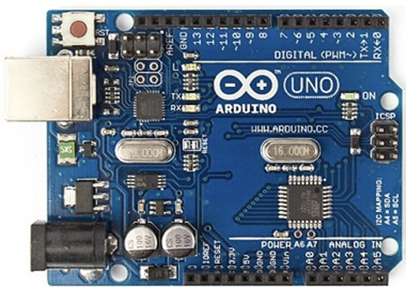
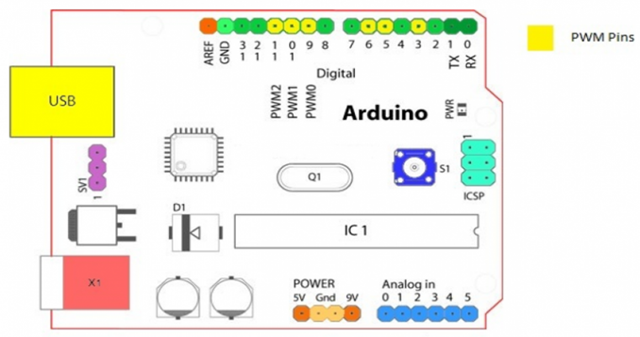
Figure 1. Arduino Board elaborative model
Figure 2. Arduino Uno R3 Board

Slide 5
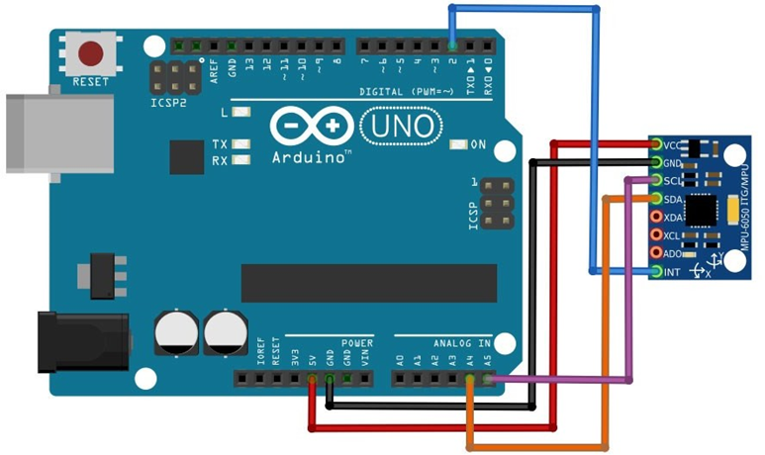
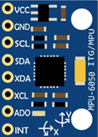
Figure 3. MPU 6050 Circuit Board
Figure 4. Configuring MPU 6050 with Arduino Uno

Slide 6
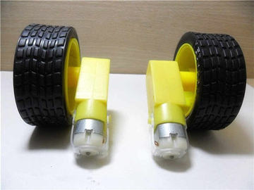
Figure 5. Plastic Robot Wheel Tire with DC3-6V Gear Motor

Slide 7
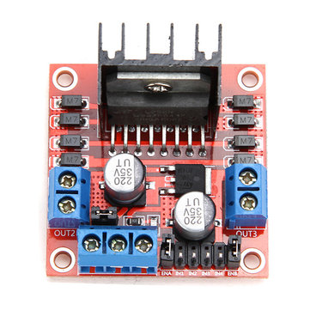
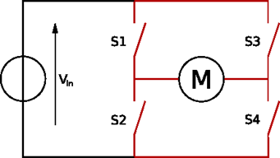
Figure 6. Dual H-Bridge L298N DC Motor Drive
Figure 7. Switches based H-Bridge for driving a DC motor both ways (FWD/ BWD)

Slide 8
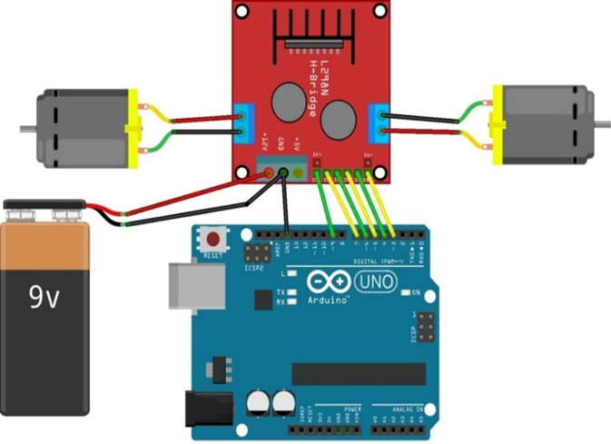
Figure 8. Configuring L298N with Arduino and DC Motors

Slide 9
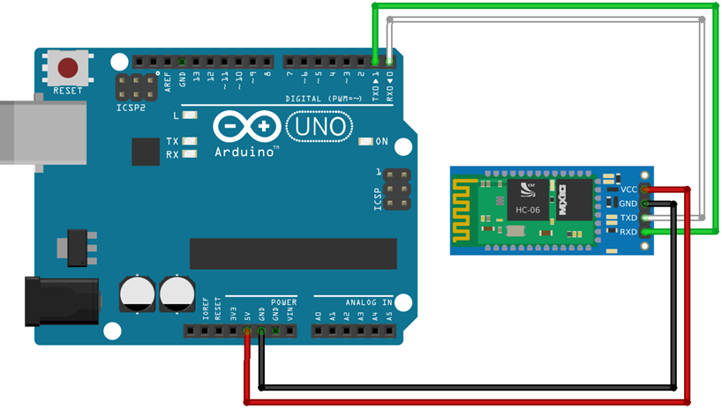
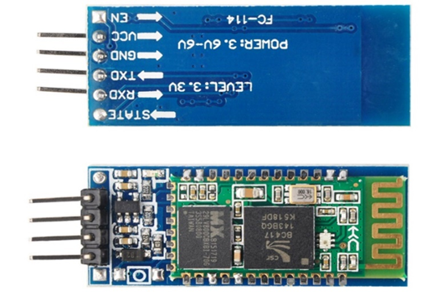
Figure 9. HC-05 Bluetooth Module
Figure 10. Configuring HC-05 with Arduino

Slide 10

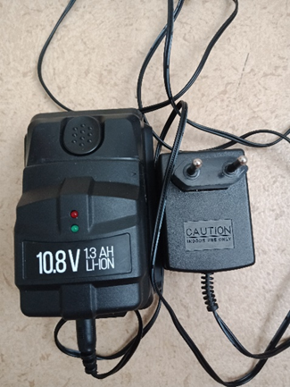
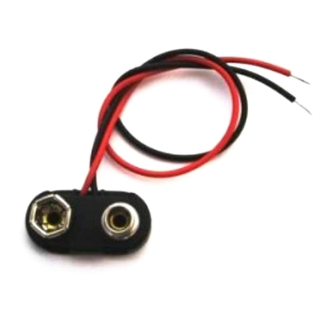
Figure 12. Battery 6V
Figure 11. Rechargeable battery 10.8 V 1.3 AH Li-ion
Figure 13. Connector

Slide 11
Software
Fritzing Software
IDE 1.8.5 Arduino Software
MIT App Inventor 2
Autodesk Inventor

Slide 12
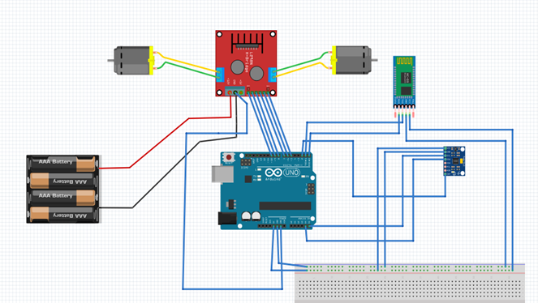
FRITZING SOFTWARE
Figure 14. Circuit representation in Fritzing, a screenshot image

Slide 13
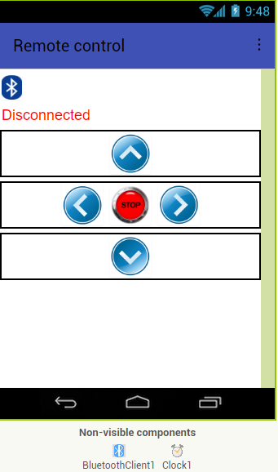
MIT APP INVENTOR 2
Figure 15. Android Interface on the MIT App Inventor 2

Slide 14
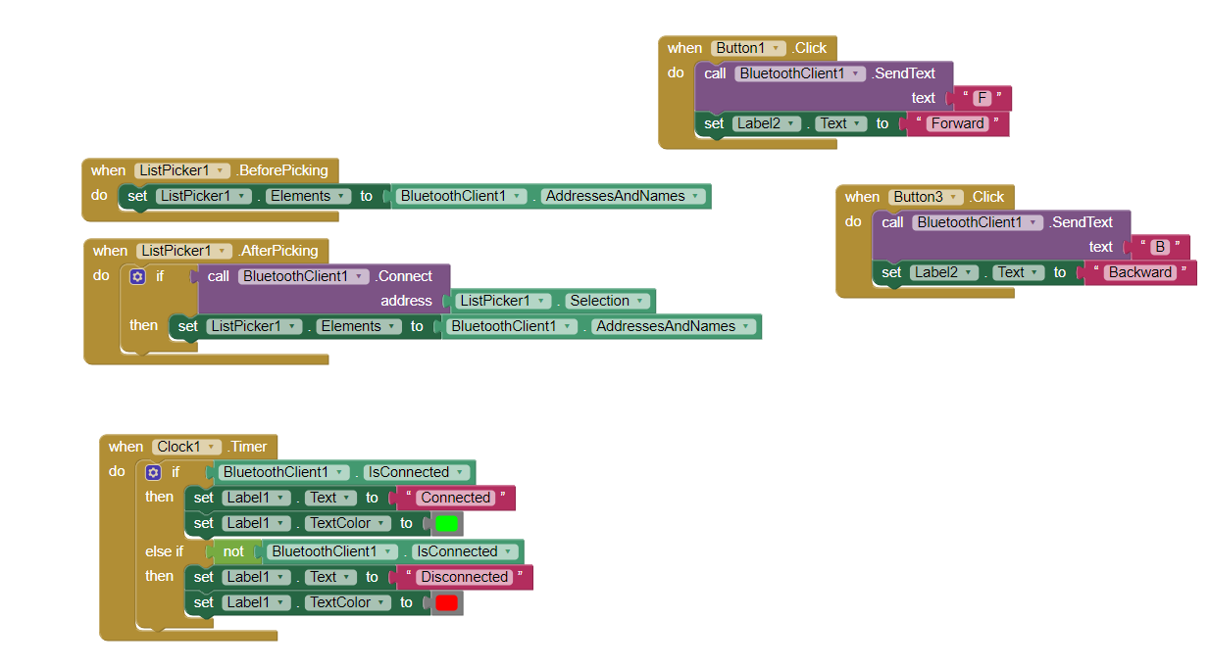
MIT APP INVENTOR 2
Figure 16. Blocks Connection on the MIT App Inventor 2

Slide 15
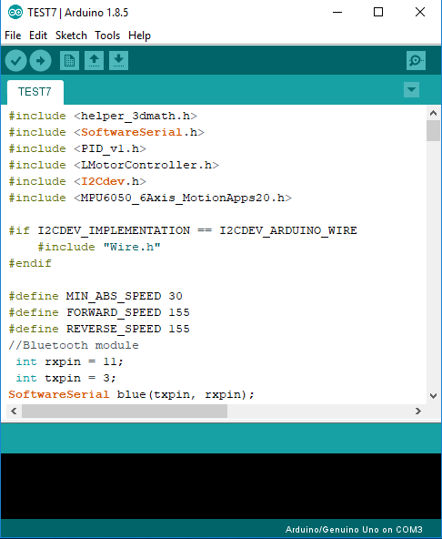
IDE 1.8.5 Arduino Software
Figure 17. Example Programming Interface

Slide 16
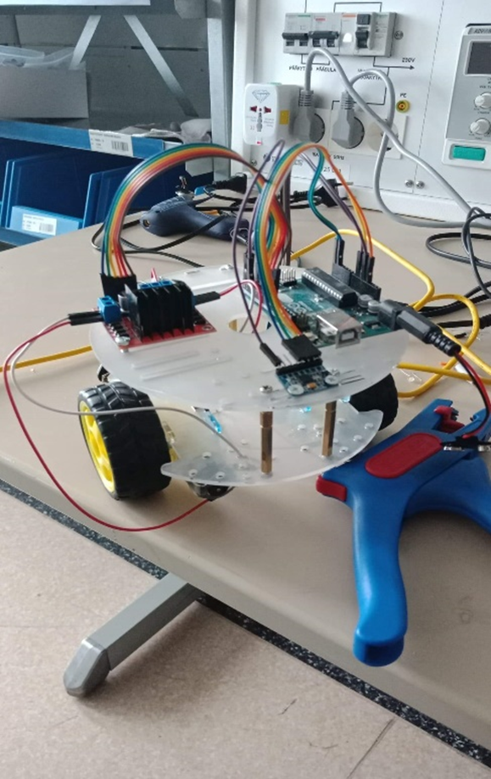
SAMPLE VERSION 1.0
Figure 18. Original version

Slide 17
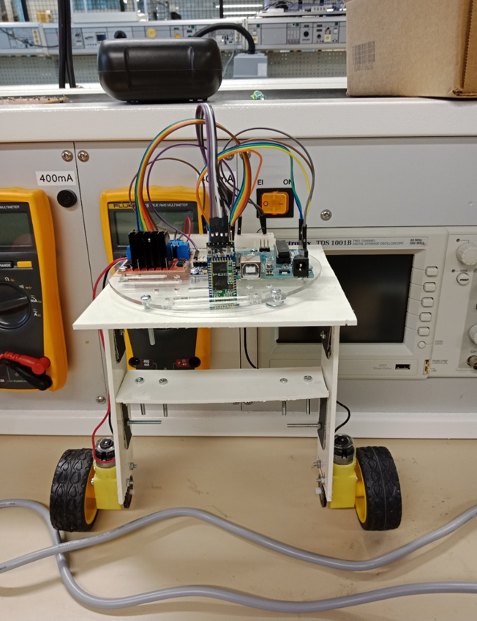
SAMPLE VERSION 1.1
Figure 19. Robot version 1.1

Slide 18
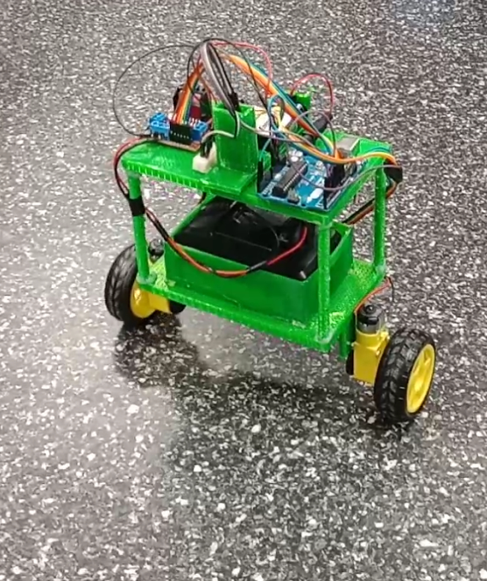
SAMPLE VERSION 1.2
Figure 19. Robot final version

Slide 19
THANK YOU FOR LISTENING

